Slide 1

FITNESS TRACKER PRICE PREDICTION
A REGRESSION ANALYSIS USING KAGGLE ECOMMERCE DATA

Slide 2

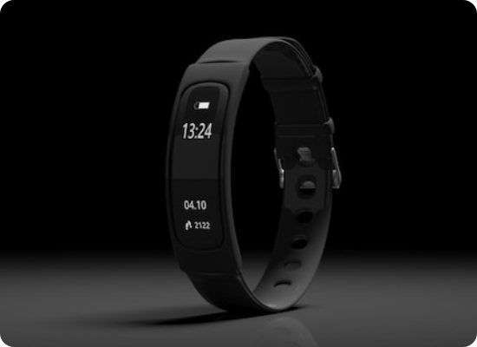
PROJECT OBJECTIVES
The goal of this project is to build a robust regression model to predict the Selling Price of fitness trackers and smartwatches.
Identify key price drivers (Brand, Specs).
Compare Linear, Ridge, and Lasso performance.
Understand market positioning through data.

Slide 3






THE DATASET
IDENTITY
SPECS
TARGET
Brand Name: (e.g., Apple, Garmin) Device Type: FitnessBand vs Smartwatch Model Name: Specific product variant.
Display: AMOLED, LCD, etc. Battery Life: Average days. Strap Material: Silicon, Leather, etc.
Selling Price: The discounted price (Target Variable). Rating: User score (out of 5). Reviews: Number of reviews.

Slide 4
DATA PREPROCESSING
Missing Values: Imputed missing values in 'Rating' with the median and 'Display' with mode.
Categorical Encoding: Applied One-Hot Encoding to 'Brand Name' (creating columns like Brand_Apple, Brand_Fitbit) and 'Device Type'.
Feature Scaling: Standardized numerical features (Battery Life, Reviews) using StandardScaler to ensure regularization works correctly.
Drop Columns: Removed 'Model Name' due to high cardinality.

Slide 5

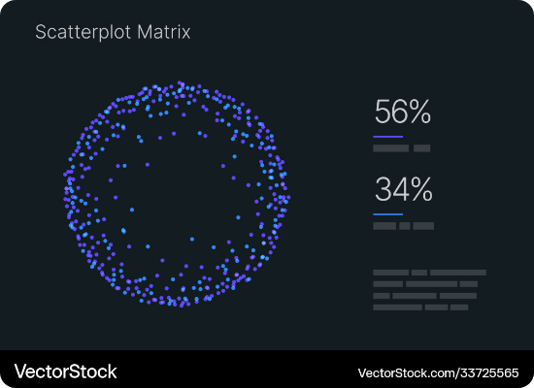
EXPLORATORY ANALYSIS
KEY INSIGHTS
Price vs. Rating: Surprisingly, higher ratings do not strictly correlate with higher prices. Budget bands often have high satisfaction.
Brand Dominance: Apple and Garmin outliers significantly skew the price distribution rightward.
Display Tech: AMOLED screens are a clear indicator of premium pricing tiers compared to LCD/TFT.

Slide 6
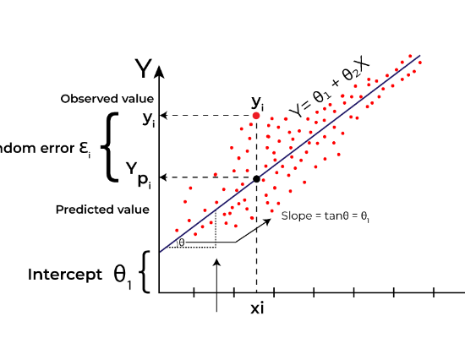

MODEL 1: LINEAR REGRESSION
THE BASELINE
We started with simple OLS (Ordinary Least Squares) regression. It assumes a linear relationship between features and price.
Pros: Interpretable coefficients. Cons: Prone to overfitting if features are highly correlated (Multicollinearity).

Slide 7
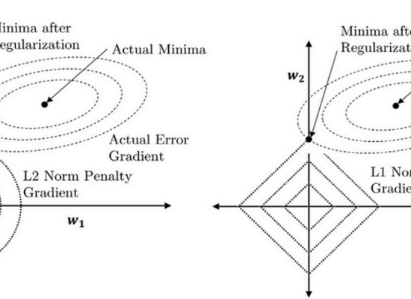


MODEL 2: RIDGE REGRESSION (L2)
HANDLING MULTICOLLINEARITY
Ridge adds a penalty equal to the square of the magnitude of coefficients. This shrinks coefficients towards zero but not exactly to zero.
Why: Essential when features like 'Battery Life' and 'Display Type' might share information.

Slide 8



MODEL 3: LASSO REGRESSION (L1)
FEATURE SELECTION
Lasso adds a penalty equal to the absolute value of the magnitude of coefficients. This can eliminate least important features by shrinking their coefficients to exactly zero.
Result: It helps identify that specific Strap Colors or minor specs have zero impact on price.

Slide 9
MODEL COMPARISON
Model | R-Squared (Test) | RMSE | MAE
Linear Regression | 0.892 | $45.20 | $32.10
Ridge Regression (L2) | 0.895 | $44.80 | $31.80
Lasso Regression (L1) | 0.894 | $45.05 | $31.95
Verdict: Ridge Regression performed slightly better, indicating that while we have many features, most of them contribute somewhat to the price (dense model) rather than just a few key ones.

Slide 10
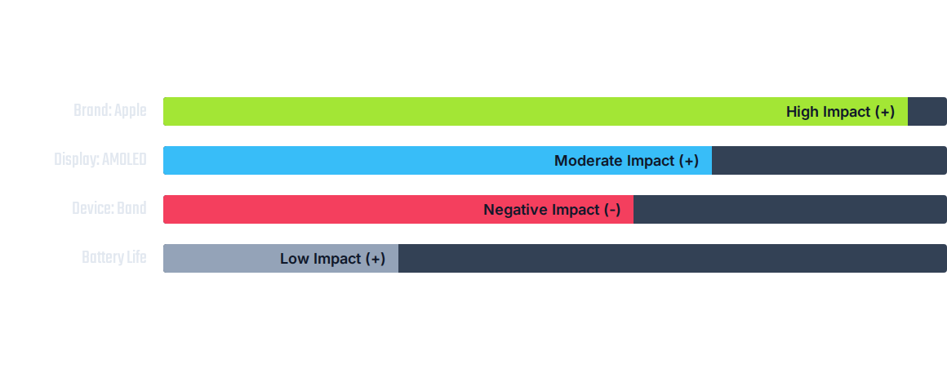
WHAT DRIVES PRICE?

Slide 11
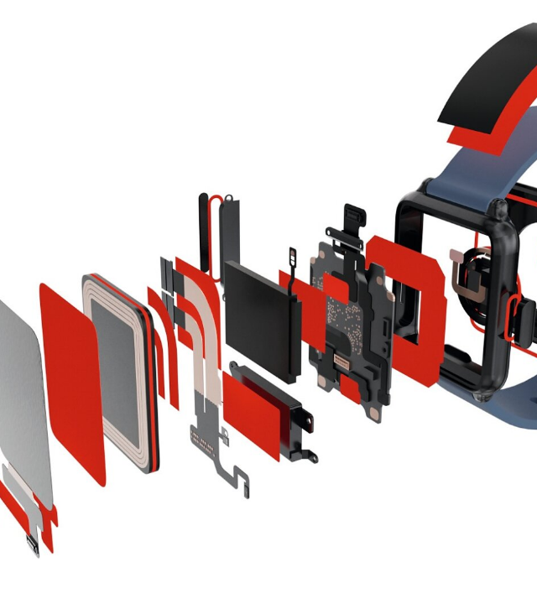
CONCLUSION
Our analysis confirms that Brand Equity is the single largest determinant of price in the fitness tracker market, often outweighing raw technical specifications.
While Ridge Regression offered the best predictive accuracy, all three models showed strong R-squared values (~0.89), suggesting the market pricing is rational and predictable based on the available data.

Slide 12
Q&A
Thank you for your time.
QUESTIONS ABOUT THE MODELS OR DATA?

Slide 13






IMAGE SOURCES
https://img.freepik.com/premium-photo/fitness-tracker-smart-watch-black-black-background-3d-illustration_771335-28233.jpg
Source: www.freepik.com
https://cdn.vectorstock.com/i/1000v/55/65/data-visualization-kit-scatterplot-matrix-vector-33725565.jpg
Source: www.vectorstock.com
https://media.geeksforgeeks.org/wp-content/uploads/20231129130431/11111111.png
Source: www.geeksforgeeks.org
https://miro.medium.com/v2/resize:fit:1200/1*Tyu8vrwWsm0qJ4BhrSdAFA.png
Source: medium.com
https://static.vecteezy.com/system/resources/previews/032/165/078/non_2x/abstract-futuristic-modern-dark-green-blue-with-shiny-geometric-green-and-blue-circle-lines-futuristic-technology-theme-design-for-poster-cover-banner-brochure-website-flyer-vector.jpg
Source: www.vecteezy.com
https://www.tesa.com/en-us/files/images/202409/2/electronics-pcb-smartwatch-explosion-illustration-cms,11599581_crop16x9_18.jpg
Source: www.tesa.com

